Slide 1
Level 2 Group Project Panos
Minhajul Hussain

Slide 2
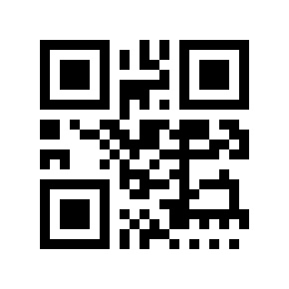
QR CODES
What is a QR CODE?
How will they be used?
A Quick Response Code is a machine readable matrix barcode that contains information about items to which they are attached.
The user will click a button which brings up a scanner which can be used to scan a QR code displayed outside a store window. The information will be retrieved from the QR code and displayed on the users screen.
What will we use them for?
How will they be implemented?
We will use them to store links to our database from which information will be gathered and displayed on the users displays, such as; website links, and menus in a given format.
The code stores information which links to specific entries in our database which will be gathered and displayed on the users screen.
I have designed a use case to showcase how this works in its simplest form. (On the next Slide)

Slide 3
QR CODES
Implementation of
Includes
Select Menu
App opens and displays landing page
User Taps Icon
Includes
Includes
User Selects (Scan QR Code)
Select (Scan QR Code)
Scanner goes to link and retrieves data
Scanner decodes and retrieves database link
User scans
QR Code
Scanner opens on the display
Includes
Includes
Includes
Includes
Includes
Key:
Scanner displays information to the user
Displays option to Scan again
Displays option to return to home screen
Includes
Areas within the app.
Above is a Use Case diagram showcasing how QR codes will be used and implemented.

